Slide 1

Credit Card Default Prediction
Analysis Report

Slide 2
Default % by Gender:
56.7%
Male
Female
43.3%
Male
Female
Insight:
Women are more defaulter i.e., 56.7% compare to men i.e., 43.3%

Slide 3
Default % by Education:
50.2%
graduate school
university
high school
30.7%
others
18.6%
0.5%
Insight:
University people are mostly defaulter

Slide 4
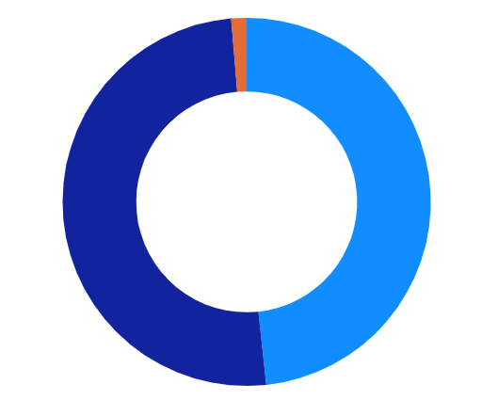
Default % by Marriage:
1.34%
married
single
others
48.31%
50.35%
Insight:
Single & married people are mostly defaulter.

Slide 5
Machine Learning Pipeline:
Data Collection
Understand the Business
Analyzed Data
ML Pipeline
Feature Engineering
Preprocessing
Split Data
Model Training
Model Evaluation
train
Store Data
test
Prediction

Slide 6
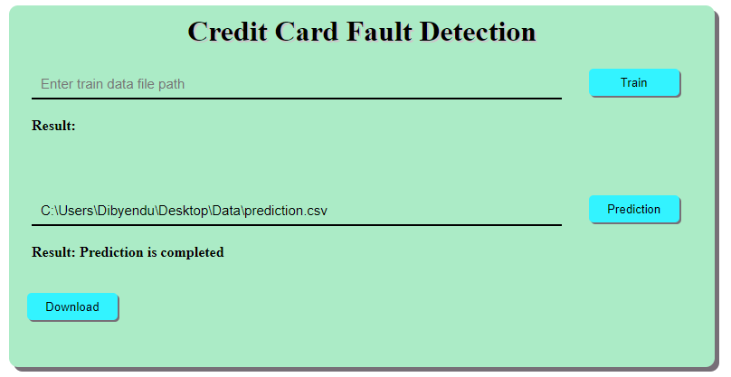
Generalized Machine Learning Model:
In this project there is no such more linear relationship between independent features and dependent feature, so we use there ML algorithms to build the model, i.e.,
RandomForestClassifier,
XGBoostClassifier.
Here, ML-Pipeline automatically select the best model based on performance matrix. Matrix Link.
After that create a web app for predict the expenses based on new test data & download the data from the web.

Slide 7

-by Dibyendu Biswas

